Slide 1

TEAM 6
Reporting On Our Progress
MIDTERM ASSIGNMENT
Fundamental of Data Analytics
Subject: Linear Regression

Slide 2





MEMBERS
NO
PAIN
NO
BÙI THU VÂN
TRẦN TRIỆU VY
LÊ THỊ THÙY LINH
GAIN
<33
HOÀNG NGUYỄN QUỲNH GIANG
LÊ CHÍ HÀO

Slide 3
Points to discuss:
State the requirements and objectives of the problem, develop research questions, propose a process - a diagram of research implementation.
Definition of Metrics/Variables
Exploratory data analysis depedent variable with Descriptive Analytics method. (EDA)
Liner Regression Model
Linear Regression Model with Categorical Variables (or called Dummy Variables)
Contents

Slide 4

State the requirements and objectives of the problem, develop research questions, propose a process - a diagram of research implementation.
1. Requirements and objectives of the problem

Slide 5
State the requirements and objectives of the problem, develop research questions, propose a process - a diagram of research implementation.
Explain the relationship between factors affecting remuneration.
- Listen to the data
- Catch mistakes in data
- See patterns in the data
- Find violations of statistical assumptions
- Generate hypotheses

Slide 6
State the requirements and objectives of the problem, develop research questions, propose a process - a diagram of research implementation.
2. Research questions

Slide 7
State the requirements and objectives of the problem, develop research questions, propose a process - a diagram of research implementation.
- How do these factors affect CEO compensation?
- Which is the biggest impact factor?
- How does the correlation of these factors affect remuneration?
- Proposed process - research implementation diagram

Slide 8

3. Propose a processing diagram of research implementation on salary
Figure 1: Processing diagram

Slide 9
Definition of Metrics/Variables
Identify specific questions from the research question posed.
What is the correlation between each independent variable and the dependent variable?
Does the type of company have any effect on CEO compensation?

Slide 10
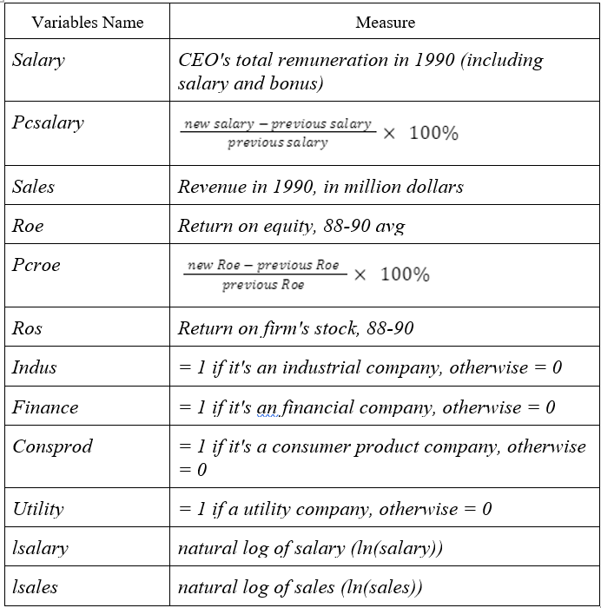
The table showing variables/metrics
Out of 12 variables, there will be 8 quantitative variables and 4 nominal variables
The dependent variable: salary, lsalary
The independent variables will be the remaining variables

Slide 11
The relationship between dependent and independent variables
The relationship between type of company and salary
From the available data, we can know the average remuneration of CEOs by type of company, specifically as follows:
Indus: including 67 CEOs and the average remuneration of each CEO is 1139.34
Finance: Including 46 CEOs and the average salary of each CEO is 1344.91
Consprod: Including 60 CEOs and the average salary of each CEO is 1722.42
Utility: Including 46 CEOs and the average salary of each CEO is 727.97
In fact, provides a theoretical explanation for a proportional relationship between size and remuneration.

Slide 12
The relationship between firm performance and salary
In the CEOSAL1 data file, there are two Metrics representing the effective operation of the company: ROE and ROS.
Based on available data, we can see most high ROE, ROS will lead to higher CEO compensation. That is, company performance can be positively correlated with CEO salary.
In fact, the degree of change in remuneration explained by ROE, ROS is not much.
The relationship between sales and salary
We can estimate a regression model that relates CEO salary to company sales
salary = β0 + β1*sales + u
It implies that a 1 unit increase in the company's sales will increase the CEO's salary by about β1 units.

Slide 13
The relationship between pcsalary and salary:
Theoretically, the higher the pcsalary percentage, the higher the remuneration received by the CEO
Therefore, the pcsalary has a positive correlation with the CEO's salary.
The relationship between lsales and lsalary
The same goes for sales' relationship with salary. We can estimate a regression model that relates CEO salary to company sales.
log(salary) = β0 + β1*log(sales) + u
The log(sales) coefficient is the estimated elasticity of wages to sales. It implies that a 1% increase in company sales will increase the CEO's salary by about β1 %.

Slide 14
Exploratory data analysis depedent variable with Descriptive Analytics method. (EDA)

Slide 15
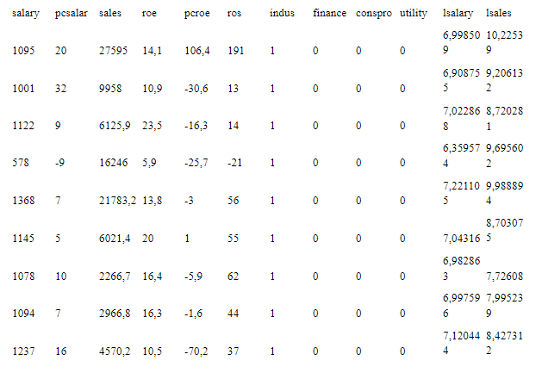
Befor we start EDA:
Let's get acquainted with Data Salary (first 10 lines):

Slide 16

We can quickly see that:
· All columns are numeric.
· The meaning of each column in this dataset is relatively clear based on the column headings.
· Here, the label column is salary or lsalary. We need to build a model that represents this column correlation (salary or lsalar) based on the remaining columns. This means the model shows the factors that can affect the CEO's salary.

Slide 17
1. Salary or Log(salary)?
The reason you’d use log(salary) is that you expect that an arithmetic (additive) change in the inputs produce a geometric (multiplicative) change in outputs. For instance, leaving your money in a 5% savings account for one extra year (adding 1) to the amount of time your money stays in a 5% savings account increases your amount of money by five percent (multiplying by 1.05). Because of that, if you were to run a regression to predict log(balance) based on years, you’d get a perfect correlation of 1.00. But if you run the regression on just balance, instead of log(balance), it woudn’t work as well.
So sometimes “salary” is the better choice, and sometimes “log(salary)” is the better choice. Which to choose depends on whether the relationship is additive or multiplicative.
Inshort,Natural log value is the more appropriate measure for computing the change in variable which follows normal distribution.
In our exercise, it is seems reasonable to use natural log of salary. But there is still no guarantee that salary is completely inappropriate. We will build models for both.

Slide 18
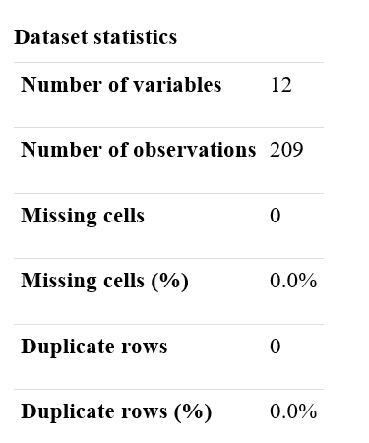
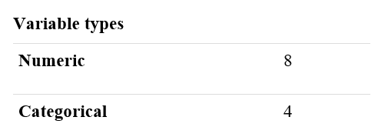
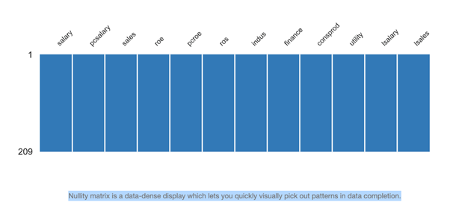
2. Data Size

Slide 19


3. Statistics of each field (and histogram)

Slide 20
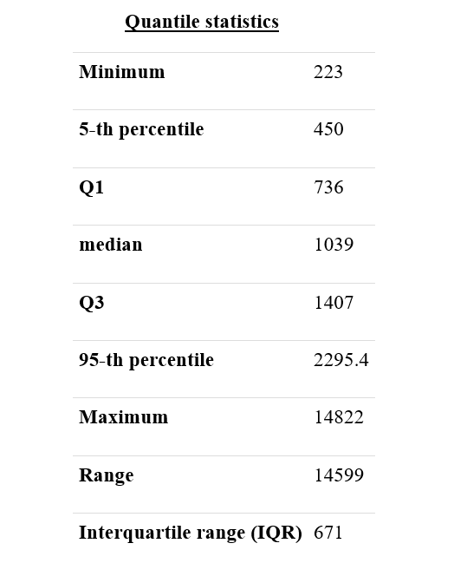
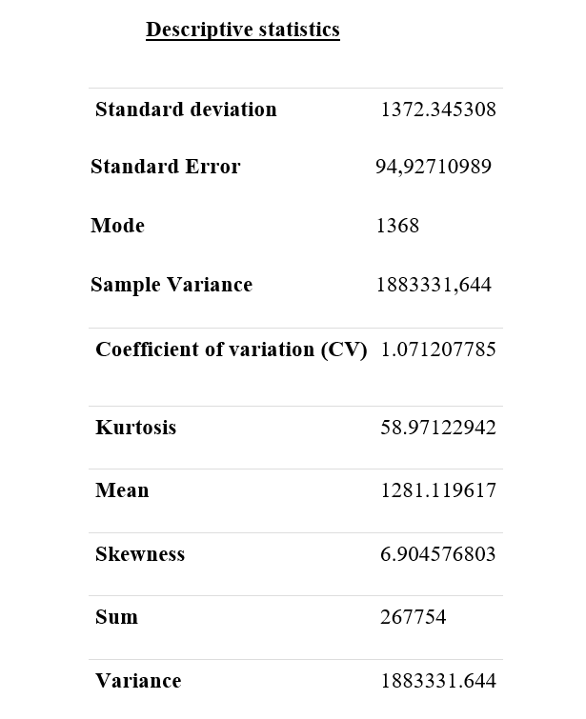
3.1. Salary (Million dollars)

Slide 21
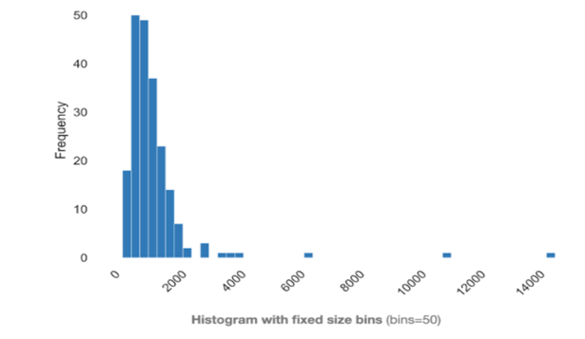
Histogram

Slide 22
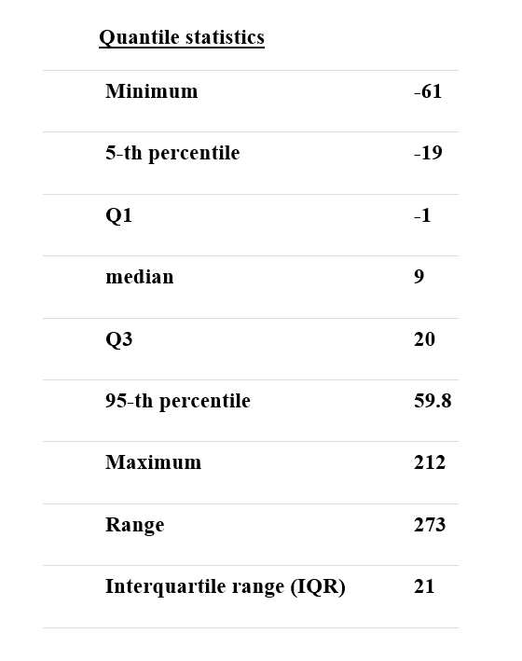
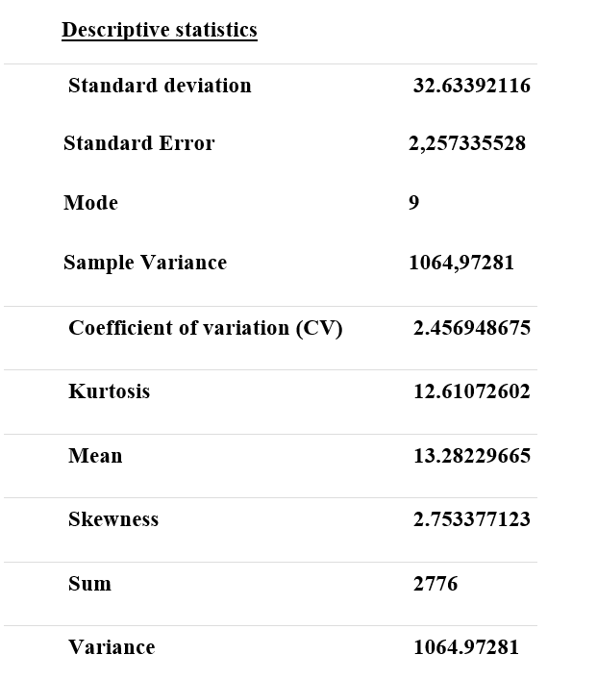
3.2. Pcsalary

Slide 23
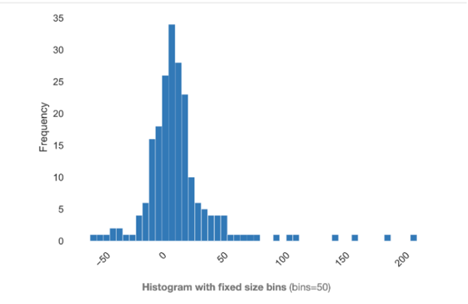
Histogram

Slide 24
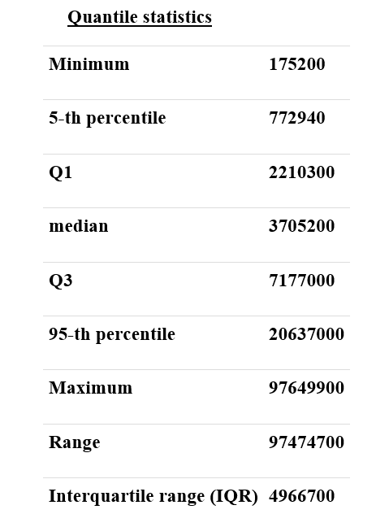
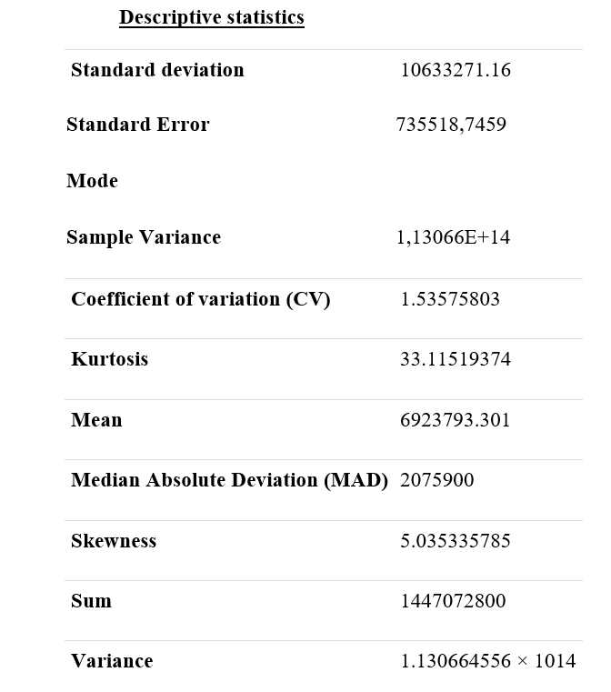
3.3. Sales (Million dollars)

Slide 25
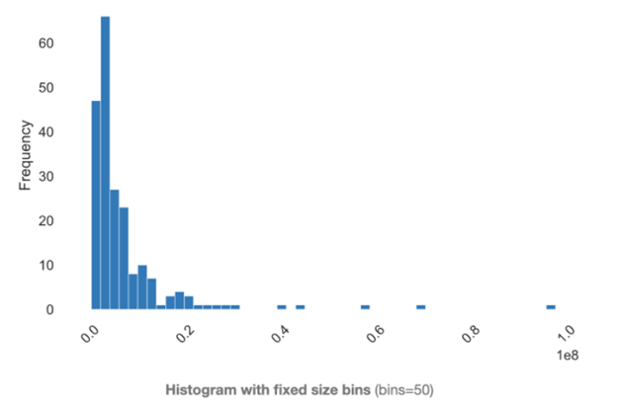
Histogram

Slide 26
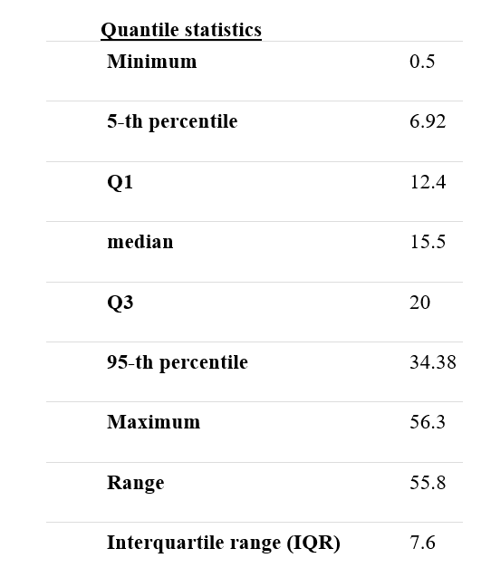
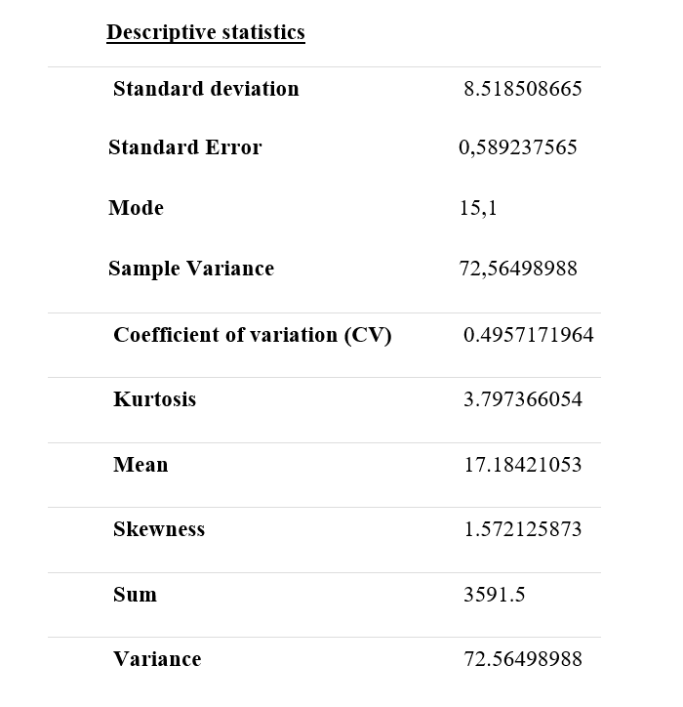
3.4. Roe

Slide 27
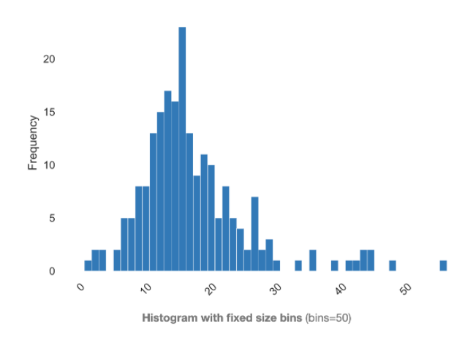
Histogram

Slide 28
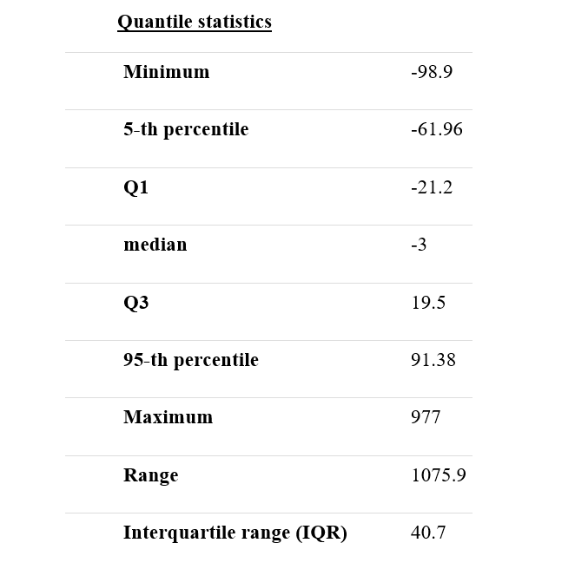
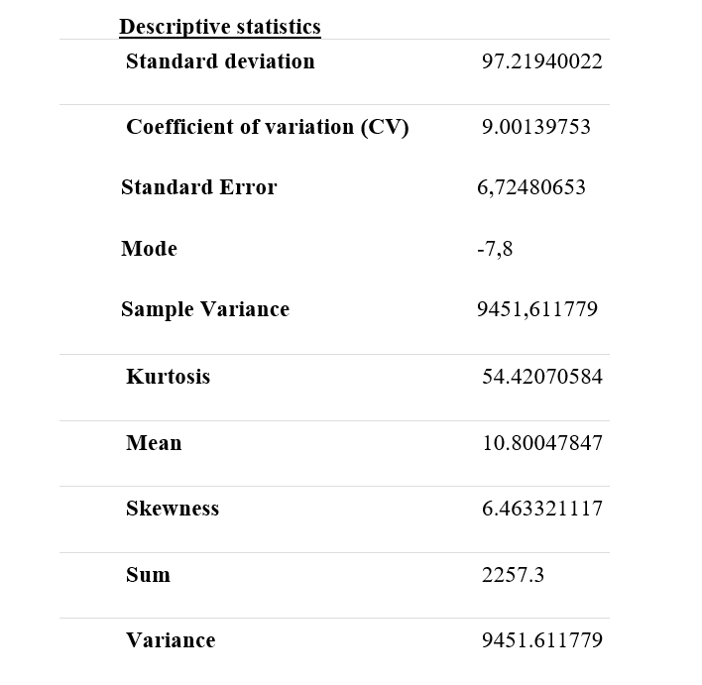
3.5. Pcroe

Slide 29
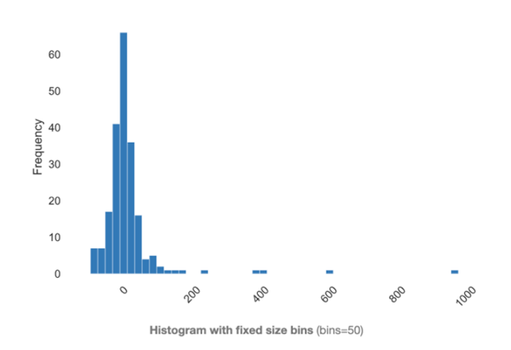
Histogram

Slide 30
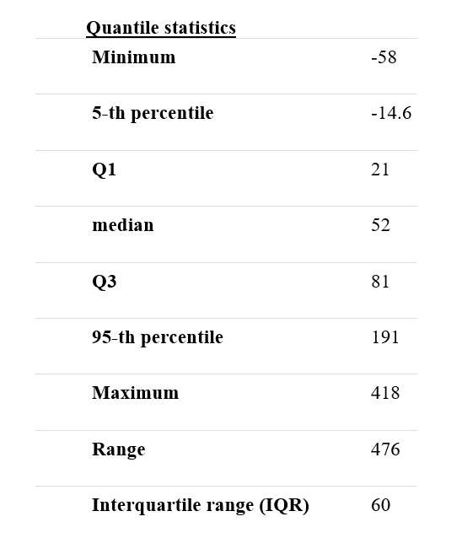
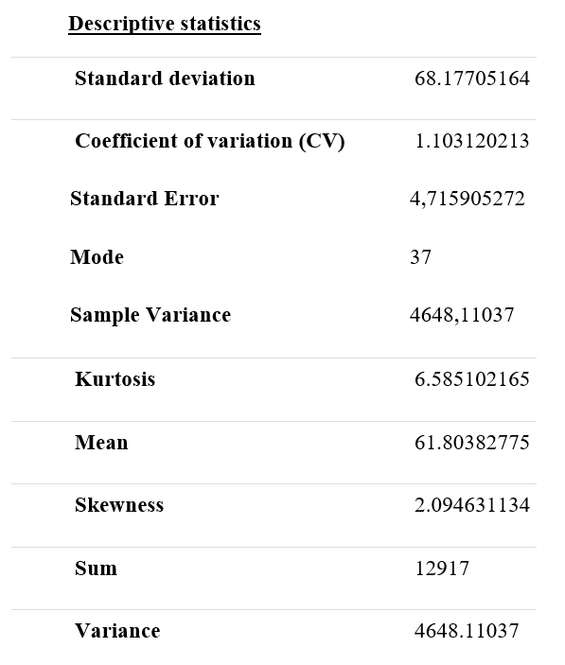
3.6. Ros

Slide 31
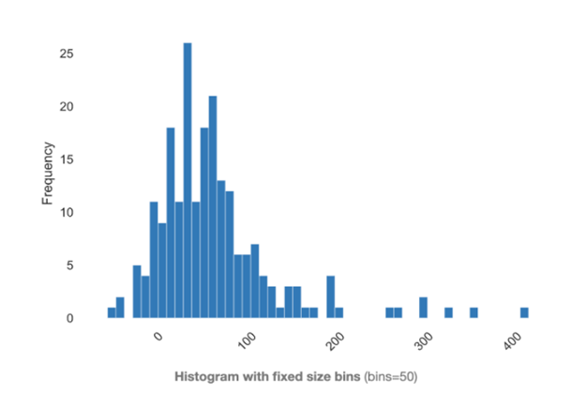
Histogram

Slide 32
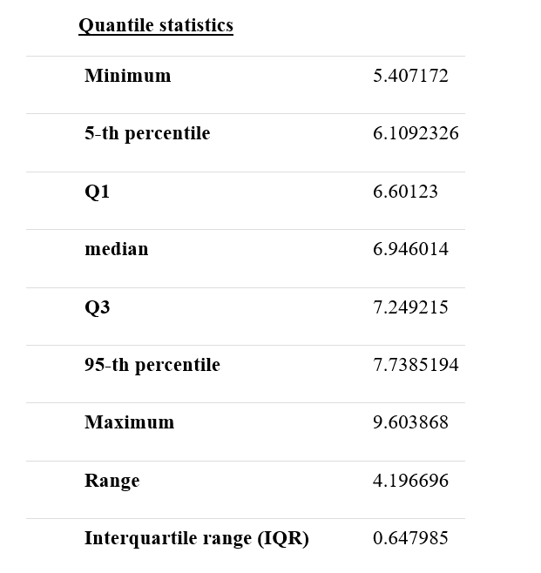
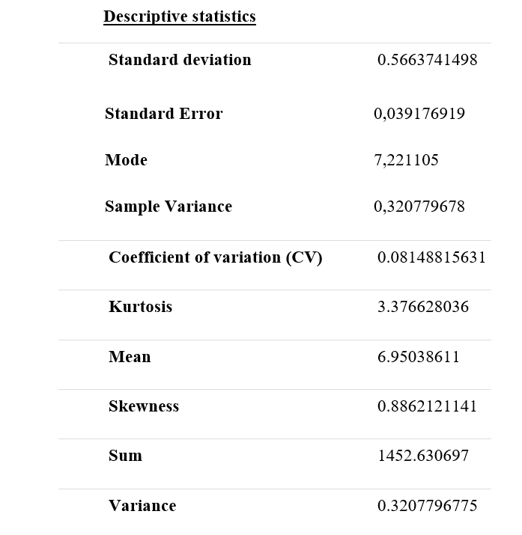
3.7. Isalary

Slide 33
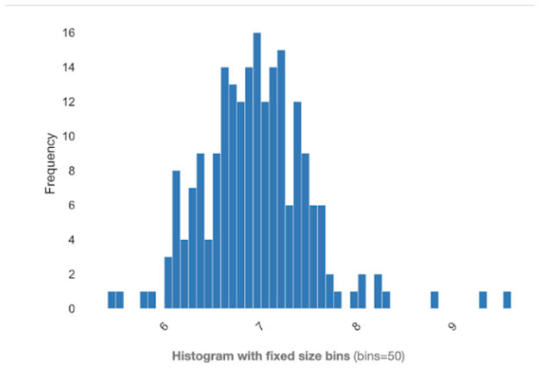
Histogram

Slide 34
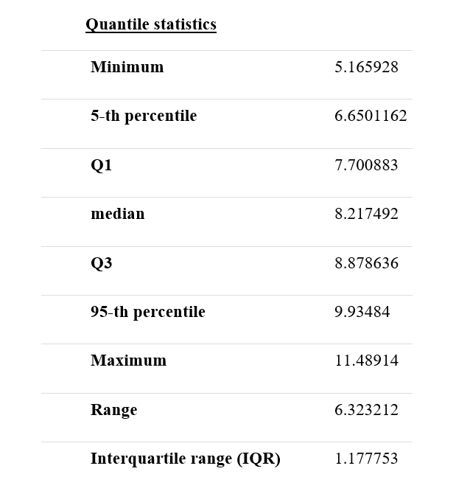
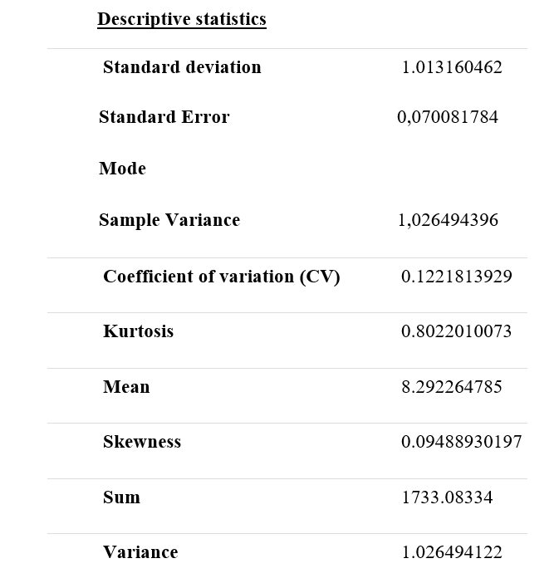
3.8. Isales

Slide 35
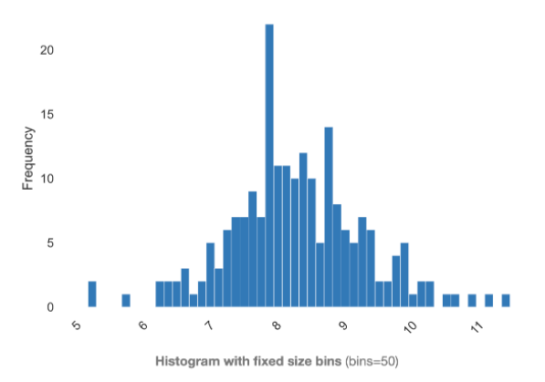
Histogram

Slide 36


4. Typical correlation between data fields

Slide 37
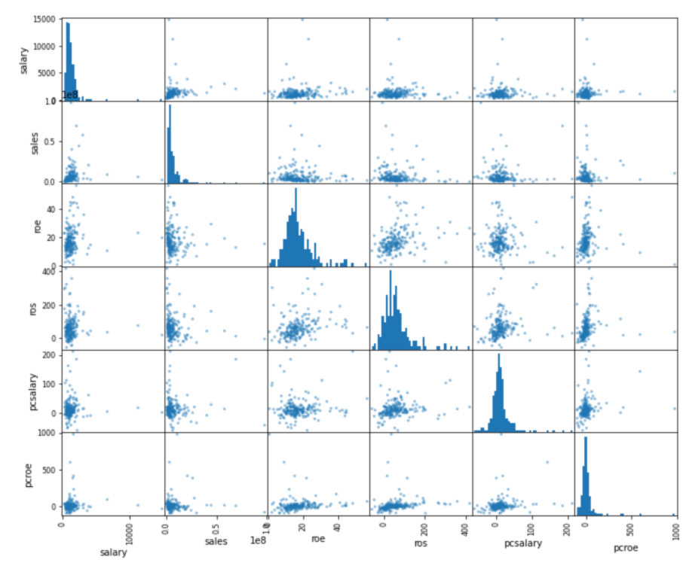
With the cell in the upper left corner corresponding to the pair of columns (salary, sales), we take the two corresponding columns as abscissa and ordinate for these points.

Slide 38
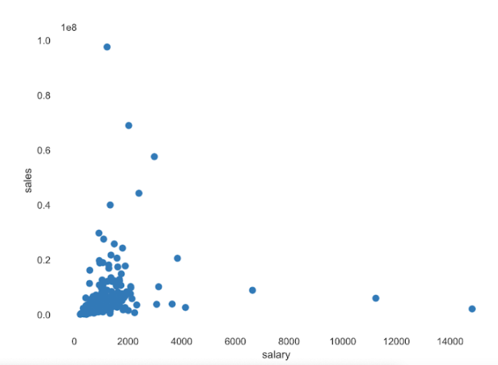

Slide 39
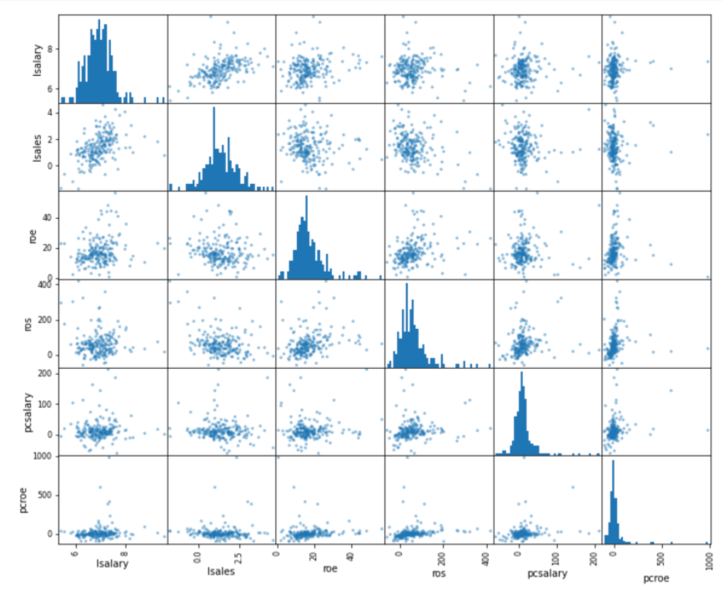
With the cell in the upper left corner corresponding to the pair of columns (lsalary, lsales), we take the two corresponding columns as abscissa and ordinate for these points.

Slide 40
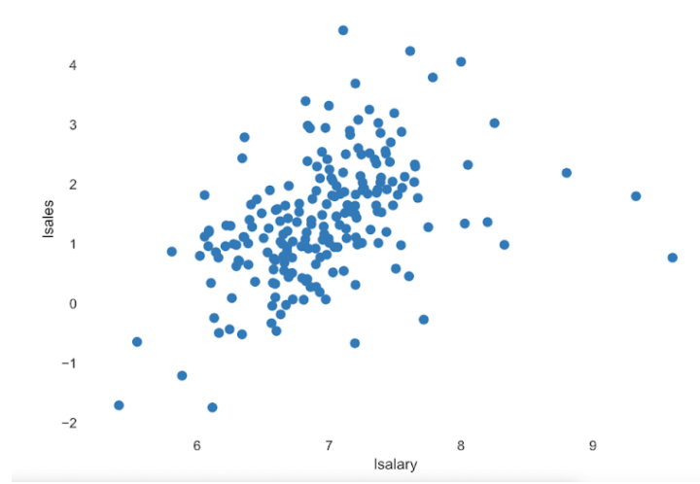

Slide 41
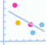
Pearson's r
The Pearson correlation coefficient (r) is a measure of the linear correlation between two variables. Its value is between -1 and +1, -1 indicates total negative linear correlation, 0 indicates no linear correlation, and 1 indicates positive total linear correlation. Furthermore, r is invariant when there are separate changes in the positions and sizes of the two variables, implying that for a linear function, the angle to the x-axis has no effect on r.
To calculate r for two variables X and Y, one divides the covariance of X and Y by the product of their standard deviations.

Slide 42
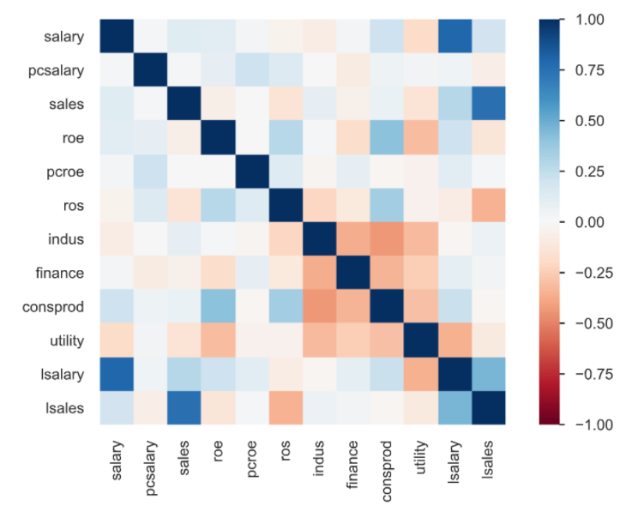

Slide 43
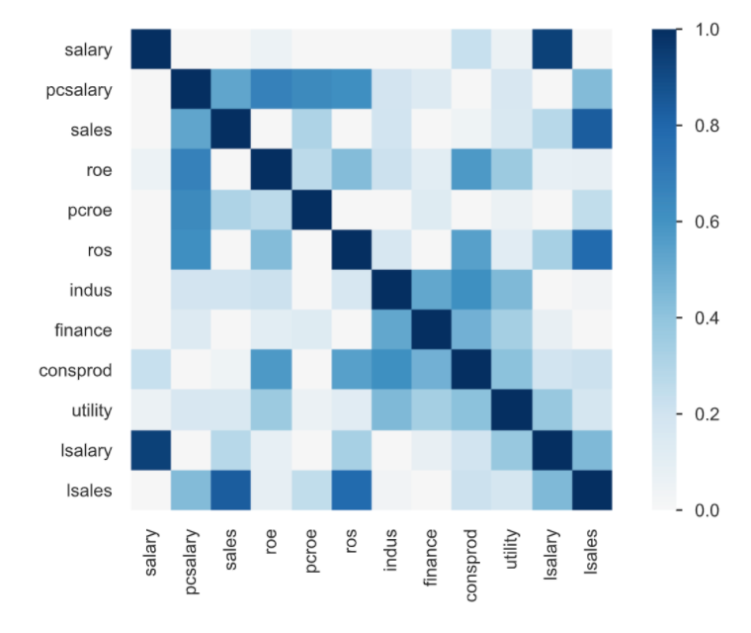
Phik matrix (φk)
Phik(φk) is a new and real correlation coefficient that active consistently across categorical, ordinal, and timescale variables, capturing the non-linear and reverting dependence on the Pearson correlation coefficient in the field in case there is normal distribution for two input variables.

Slide 44
5.Outlier points
There are two groups of outliers:
The values ​​are not in the specified range of the data. For example, age, income or distance cannot be negative.
Values ​​are likely to occur but the probability is very low. For example, 120 years old, income 1 million dollars/month. These values ​​are likely to occur but are actually rare.
How to handle:
With data belonging to the first group, we can consider it as a missing value.
For data belonging to the second group, people often use the method of upper or lower bound (clipping or capping).
As analyzed in the section “Statistics of each field” with histogram, we have noticed that variables such as “salary”, ”pcsalary”, ”sales”, ”pcoe”, ”ros” have skewed data. right (or left) pretty much. It may be due to the effect of external variables or outliers.

Slide 45
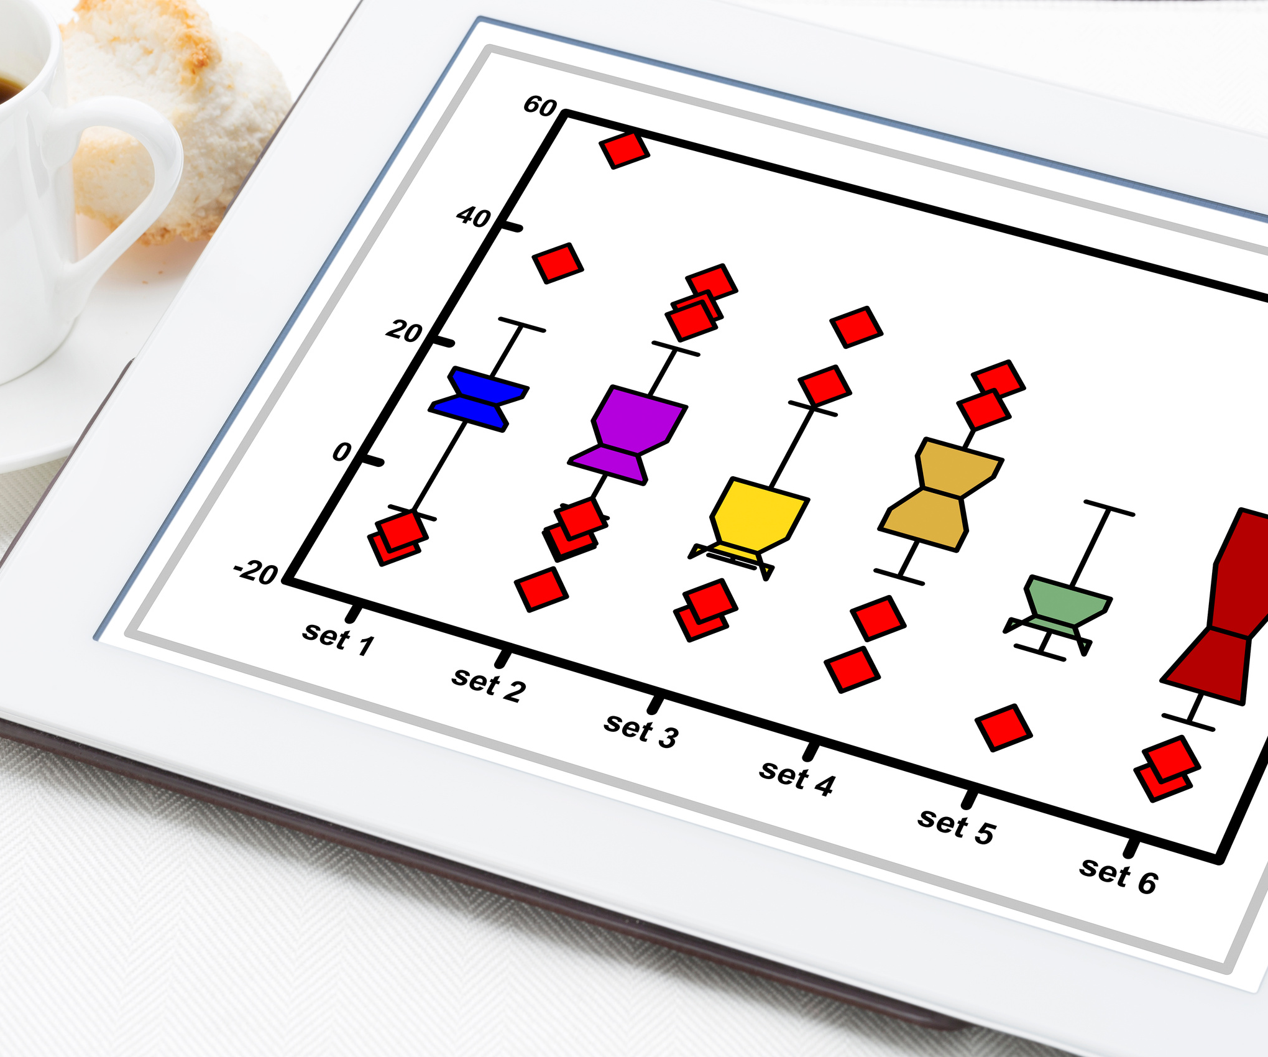
Box Plot:
The box plot not only helps to determine if the data has outliers, but also helps to find the maximum and minimum thresholds to be intercept.

Slide 46
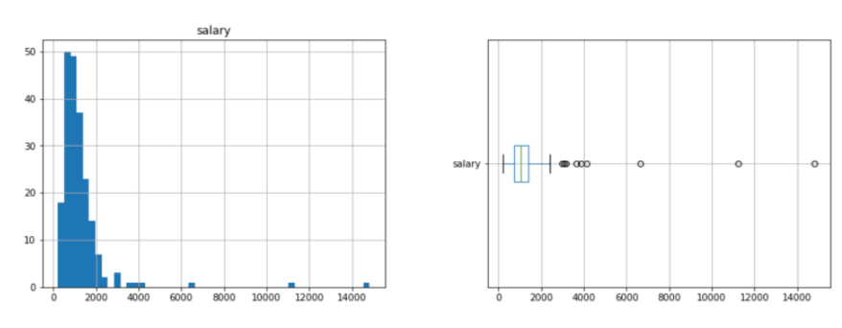
Let's start with the "salary" column:

Slide 47
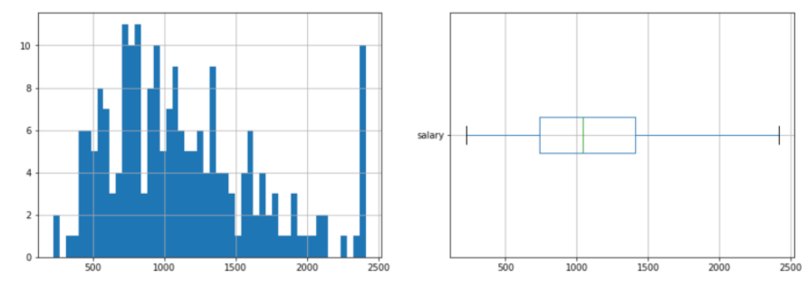
Let's start with the "salary" column:

Slide 48
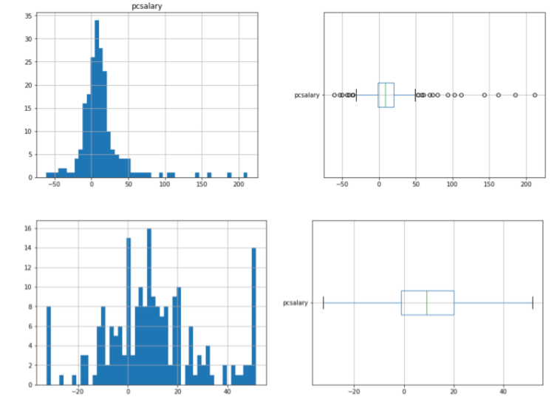
Let's start with the "pcsalary" column:

Slide 49
Let's start with the "pcsalary" column:

Slide 50
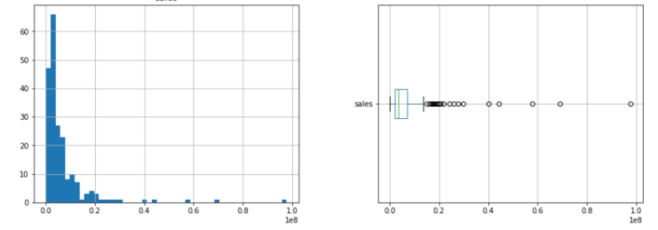
Let's start with the "sales" column:

Slide 51
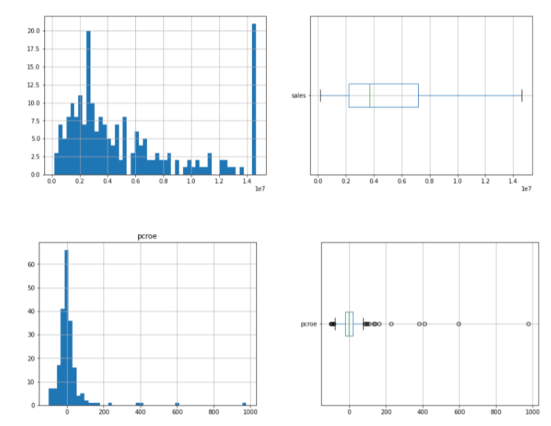
Let's start with the "sales" column:

Slide 52
Let's start with the "pcroe" column:

Slide 53
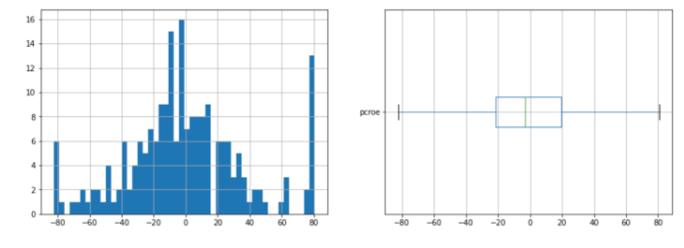
Let's start with the "pcroe" column:

Slide 54
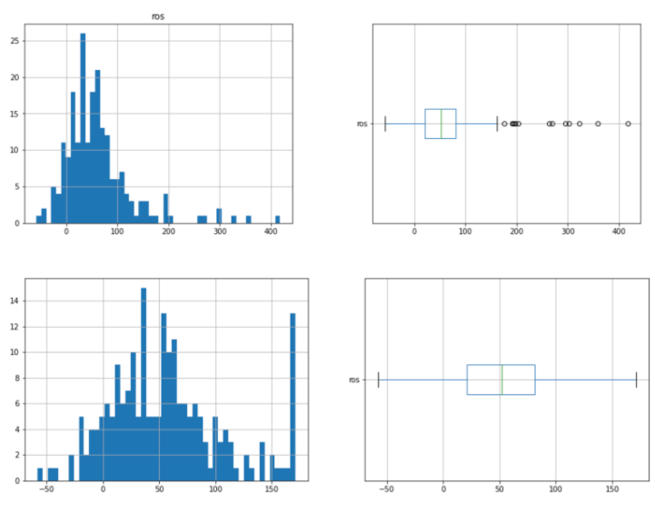
Let's start with the "ros" column:

Slide 55
Let's start with the "ros" column:

Slide 56






























Handle Outliers
in dataset
before building
regression model

Slide 57
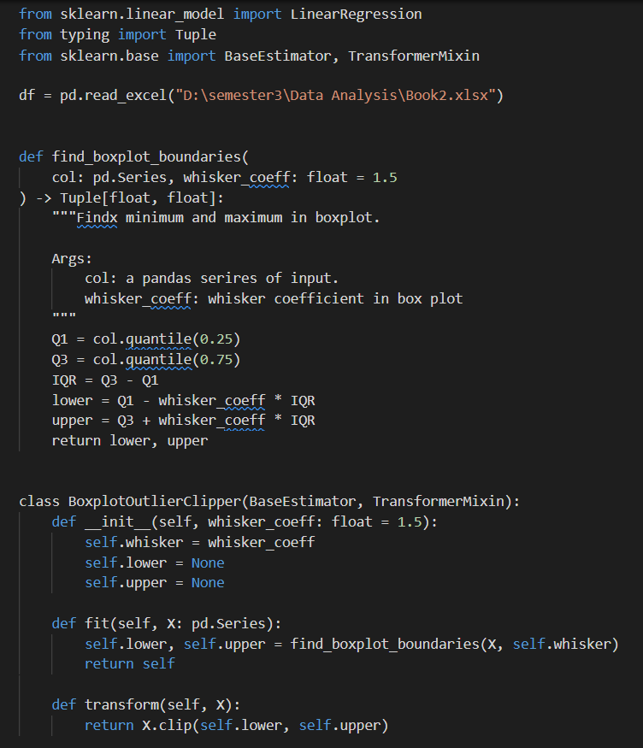
Handle variables

Slide 58
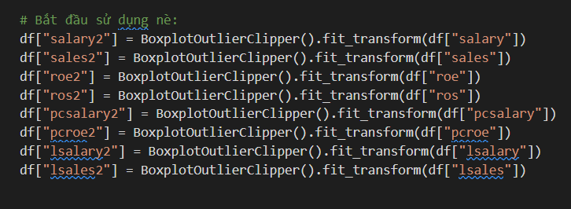
Call out variables

Slide 59
Liner Regression Model
250
200
Note: This is an example ->
150
100
50
0
0
10
20
30

Slide 60
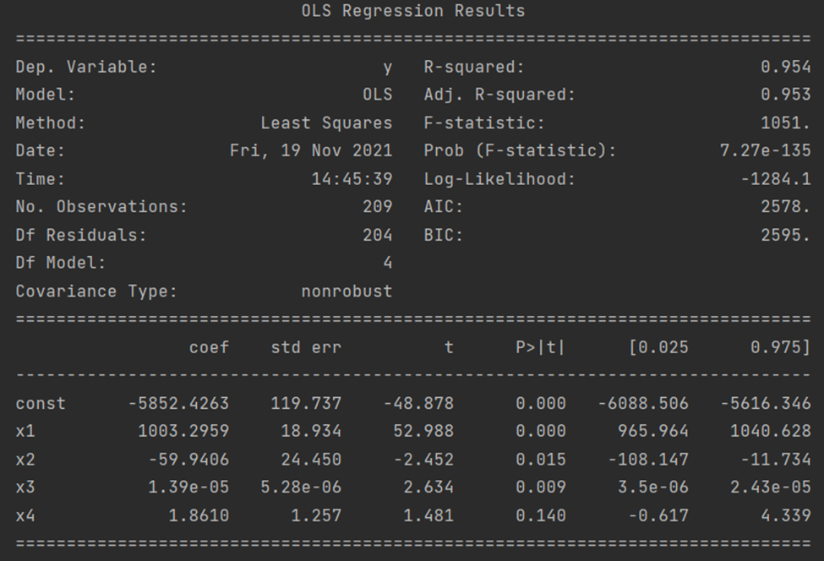
1. Model (1) – 5 variables: salary, lsalary, lsales, sales, roe
salary = -5852.4263 + 1003.2959*lsalary – 59.9406*lsales + 1.39e-05*sales + 1.8610*roe

Slide 61
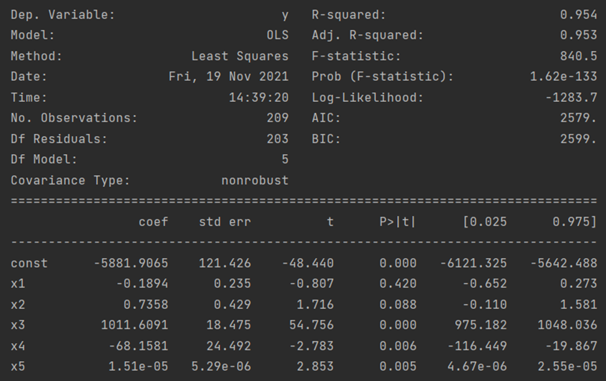
2. Model (2) – 6 variables: salary, pcroe, pcsalary, lsalary, lsales, sales
salary = -5881.9065 – 0.1894*pcroe + 0.7358*pcsalary + 1011.6091*lsalary -68.1581*lsales + 1.51e-05*sales

Slide 62
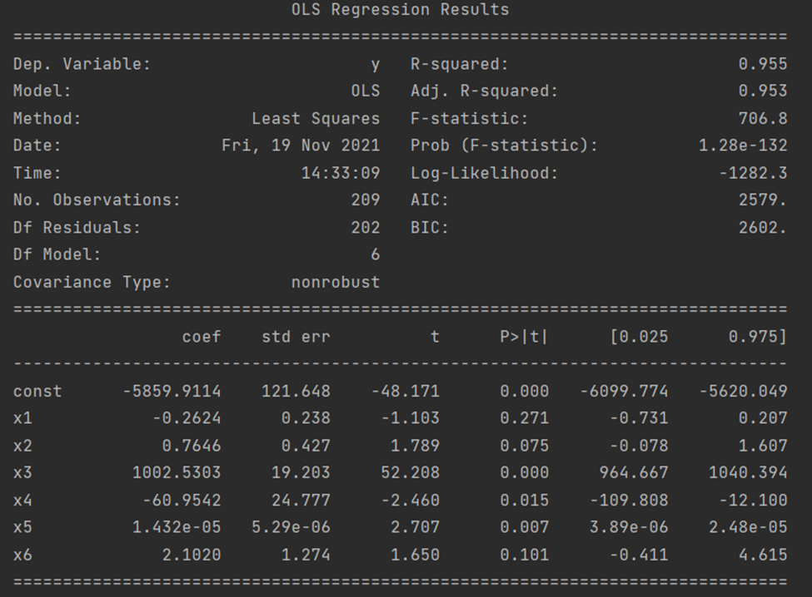
3. Model (3) – 7 variables: salary, pcroe, pcsalary, lsalary, lsales, sale, roe
salary = -5859.9114 - 0.2624*pcroe + 0.7646*pcsalary + 1002.5303*lsalary -60.9542*lsales + 1.432e-05*sales + 2.1020*roe

Slide 63
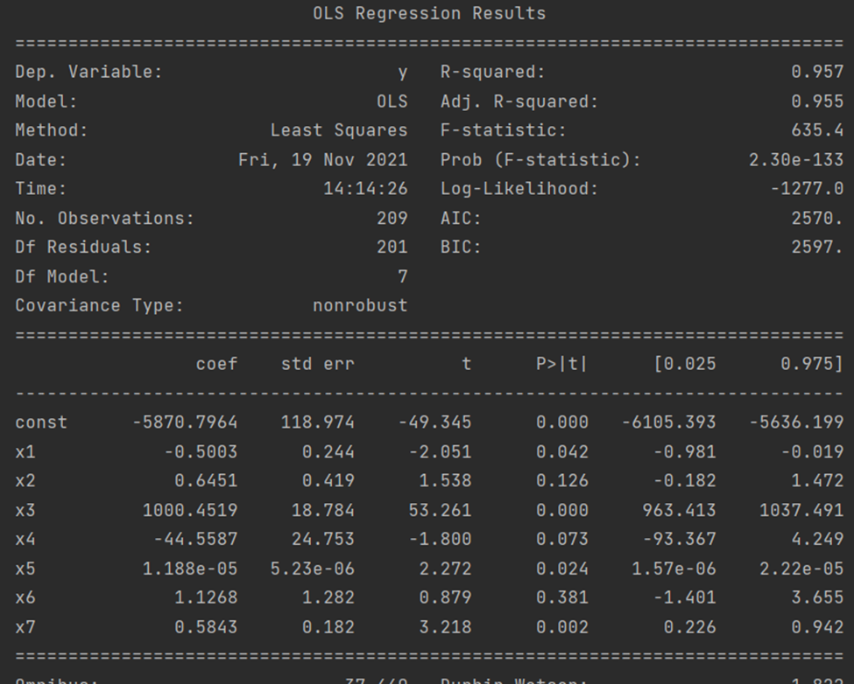
4. Model (4) – 8 variables: salary, pcroe,pcsalary,lsalary,lsales,sale,roe,ros
salary = -5870.7964 - 0.5003*pcroe + 0.6451*pcsalary + 1000.4519*lsalary -44.5587*lsales + 1.188e-05*sales + 1.1268*roe + 0.5843*ros
Multicollinearity?

Slide 64

5. Model (4.1) – 6 variables: salary, pcroe, pcsalary, sale, roe, ros
salary = 319.7283 +19.4767*pcroe + 0.8241*pcsalary + 1.0536*sales + 2.4510*roe + 300.3779*ros

Slide 65


Slide 66

Linear Regression Model with Categorical Variables (or called Dummy Variables)

Slide 67


Slide 68

Y = 345.5370 + 5.4e-05sales + 13.0313 roe + 0.6297 ros + 199.6952Z1 + 360.1229Z2 + 350.4280Z3 + u

Slide 69

Y = 345.5370 + 5.4e-05sales + 13.0313 roe + 0.6297 ros + 199.6952Z1 + 360.1229Z2 + 350.4280Z3

Slide 70




Hypothesis review:

Slide 71
THANK FOR LISTENING
Do you have any questions?

